Slide 1
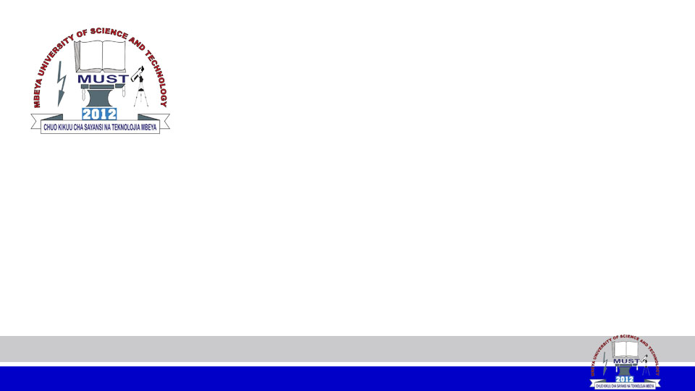
NETWORKING FUNDAMENTALS
MODULE CODE: IT 6123
MODULE NAME: Network Design and Management
FACILITATOR: Pangahela, R. A
Email: pangriz@gmail.com Phone: +255 742 926 569

Slide 2
NETWORKING FUNDAMENTALS
  Networks Definition ‘s & Benefits
  Area Networks
  Networks Categories
  Networks Elements
  Networks Designs/Topologies

Slide 3
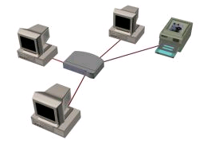
What is a Computer Network?
Computer Network is a collection of computers, and other devices, or peripherals connected together through connecting media. (Collection of Devices that can communicate together)
A fabric that ties business applications together.

Slide 4
What do you need to build a computer network?
  Computers / Peripherals
  NICs – (Currently most computers come with built-in NICs)
  Connecting Media ( Ethernet cable, etc.)
  Networking Device(s)
      Routers
      Switches
      Bridges
      Hubs

Slide 5
What do you need to build a computer network?
  Cont..
    Software
    Internet, WAN & Internet Service Provider
    Protocols
        Communication rules that all entity must agree on

Slide 6
What is an internetwork?
  Is a random collection of networks interconnected to provide some sort of host-to-host packet delivery service. (OR) Can be defined as a collection of individual networks, connected by intermediate networking devices, that functions as a single large network.

Slide 7
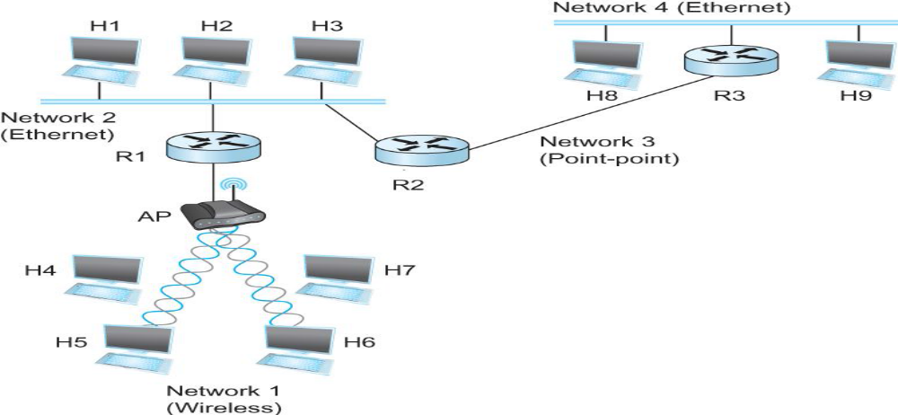
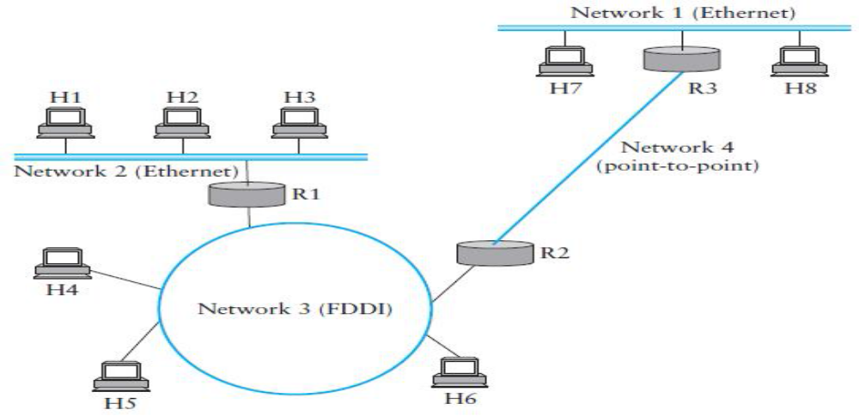

Slide 8
Applications that use the Network
  Web Browser and FTP
  Database Applications
  Instant Messenger
  E-mail
  Online Games

Slide 9
Benefits of Computer Networks
Resources Sharing
    File Sharing
    Peripheral Sharing
Software Sharing with multi-user licenses.
Shared Internet Access
Calculations Distribution

Slide 10
Consideration For Network Applications
Speed
  Bit : Computers work /process data in one's or zero's. This is 1 or 0 level of storage.
  Byte: A byte consists of eight bits.
  Kilobyte: consists of 1024 bytes.
  Megabyte: consists of 1024 kilobytes
  Gigabyte: consists of 1024 megabytes.
  Terabyte: consists of 1024 gigabytes.

Slide 11
Consideration For Network Applications
Cont..
  Petabyte: consists of 1024 terabytes.
  Exabyte: consists of 1024 petabytes.
  Zettabyte: consists of 1024 exabytes
  Yottabyte: consists of 1024 zettabytes.

Slide 12
Consideration For Network Applications
Delay - refer to the time taken for data packets to travel from their source to their destination.
  Transmission Delay: This is the time taken from the first bit of a file to reach a link until the last bit to reach the link.
  Propagation Delay: The time a bit on the link needs to travel from the source to the destination, influenced by the medium of communication.

Slide 13
Consideration For Network Applications
  Cont..
    Queuing Delay: time the packet spends in routing queues
    Processing Delay: time it takes a router to process the packet header.
  Availability (Uptime) - is a measure of how well a computer network - whether a local area network (LAN) or a wide-area network (WAN) - can respond to the connectivity and performance demands placed on it.

Slide 14
Area Networks
Local Area Networks (LAN)
  Is a group of computers connected in small geographical area
  Allow users to share files and services
  E.g. a home, office, campus, or group of buildings
Metropolitan Area Networks (MAN)
  It connects an area larger than a LAN but smaller than a WAN, such as a city, with dedicated or high-performance hardware.

Slide 15
Area Networks
Wide Area Networks(5 to 10 KM)
    A WAN is a group of computers connected in Large geographical area such as country
    A WAN often connects two LANs (WAN Link)
    Covers a broad area (i.e., any network whose communications links cross metropolitan or regional boundaries).
    Or, less formally, a network that uses routers and public communications links.

Slide 16
Area Networks
Cont..
  Compare with, LANs or MANs which are usually limited to a room, building or specific metropolitan area (e.g., a city) respectively.
  The largest and most well-known example of a WAN is the Internet.
  WANs are used to connect LANs and other types of networks together, so that users and computers in one location can communicate with users and computers in other locations.

Slide 17
Area Networks
Cont..
  WANs are built for one particular organization private.
  Others, built by ISP provide connections from an organization's LAN to the Internet.
  WANs have higher data transfer rates
  WANs are often built using leased lines.

Slide 18
Network Categories
Two basic types of networks
      Peer-to-Peer Networks
      Client/Server Networks

Slide 19
Peer-to-Peer Networks
In a P2P, all computers are considered equal; they all have the same abilities to use the resources available on the network.
Various computers on the network can act both as clients and servers. For instance, many Microsoft Windows based computers will allow file and print sharing. These computers can act both as a client and a server and are also referred to as peers.
  Example : Windows Workgroup

Slide 20
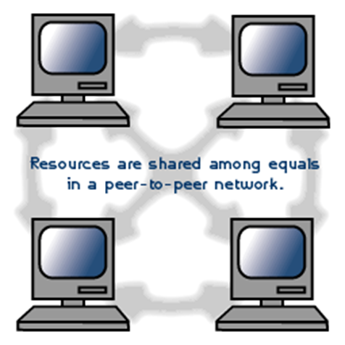
Peer-to-Peer Networks
Cont..
  Use case of P2P : Blockchain, BitTorrent, Skype etc.

Slide 21
Peer-to-Peer Networks
Authenticating users in a Computer network
  Employees in any organization, big or small, need to log in to their computers at the start of their work day.
  Logging in gives them access to shared files, folders, printers, critical applications related to work, as well as the internet.
  Organize need to authenticate and verify the identity of each user before they gain access to these resources-but how and why?

Slide 22
Peer-to-Peer Networks
Cont..
  The method you use to authenticate and verify users depends on the type of computer network setup in your work environment.
There are two major types of network setup;
  Workgroup environment
  Active Domain environment

Slide 23
Windows Workgroup
Is a P2P n/w setup using Microsoft Windows OS. OR
It is a group of computers on a LAN that share common resources and responsibilities.
    You can easily create a workgroup by connecting two or more PCs without going through a separate server computer.
In this setup, each computer on the n/w is physically connected to a router or switch.

Slide 24
Windows Workgroup
While a workgroup is a group of computers that are connected to a network, it’s not the same as a network.
    You can connect a computer to your network without making it a member of a specific workgroup.
There is no central control in a Workgroup.
    Every PC in a Workgroup is a server and a client at the same time.

Slide 25
Windows Workgroup
A PC will act as a client when it seeks to a resource in another PC.
The PC which needs to provide the access to its resources will act as a server during the process of authentication and authorization.
  Example, If Ally wants to use Halima’s computer, his username and password need to be created on Halima’s computer.

Slide 26
Windows Workgroup
Procedure

Slide 27
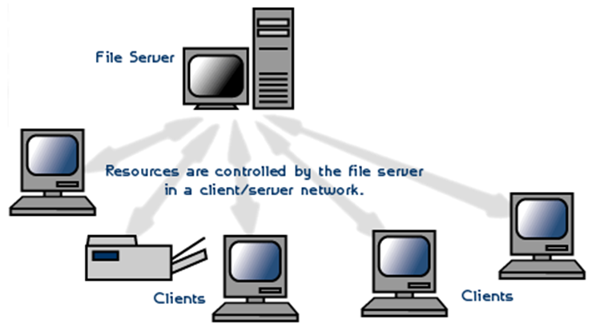
Client/Server Network
In a server based network, there are computers set up to be primary providers of services such as file service or mail service. The computers providing the service are called servers and the computers that request and use the service are called client computers.
Examples:
    Mail Server
    Web Server

Slide 28
Client Server Model
Servers are those computers who reply with services to clients. Clients are those computers who request services from servers.
First, client initiates a request sent to a certain server, then the server replies with the service required to the client.
As we see in next slide, there are many clients and one server, (actually, the number of servers is very small compared with the number of clients)

Slide 29
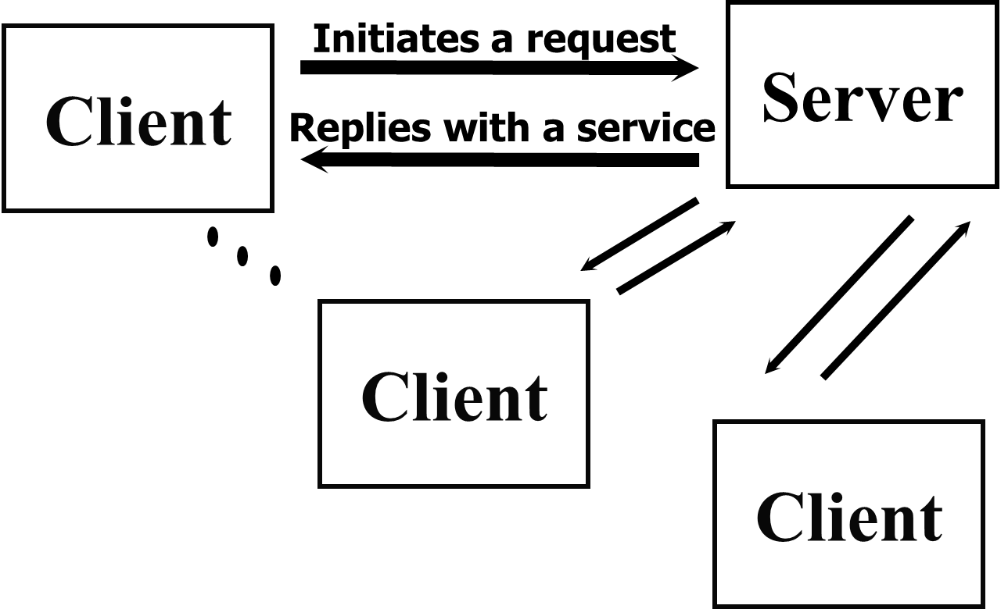
Client Server Model

Slide 30
Network Designs/Topologies
Topology refers to the shape of a network, or the network's layout.
How different nodes in a network are connected to each other and how they communicate are determined by the network's topology.
The choice of topology is dependent upon
    Type and number of equipment being used
    Cost

Slide 31
Network Topologies
Network topology : it is the structure, consisting of paths and switches, that provides the communications interconnection among nodes of a network.
Network topology is the study of the arrangement or mapping of the elements (links, nodes, etc.) of a network, especially the physical (real) and logical (virtual) interconnections between nodes.

Slide 32
Network Topologies
Computer networks topologies
  Bus
  Star
  Ring
  Mesh
  Hybrid

Slide 33
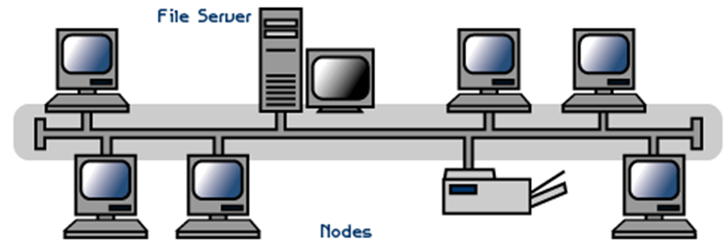
Bus Topology
All devices are connected to a central cable, called the bus or backbone.

Slide 34
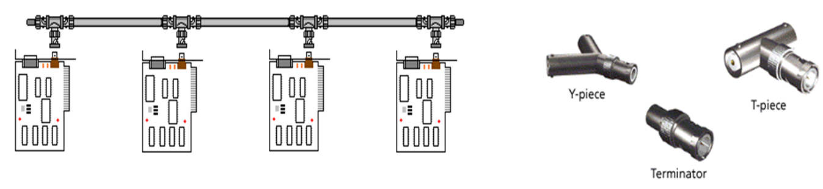
Bus Topology
Both ends of the network must be terminated with a terminator.
A barrel connector can be used to extend the network.

Slide 35
Bus Topology
The backbone functions as a shared communication medium
Device wanting to communicate with another device on the network sends a message onto the backbone
The message is heard by all stations, but only the intended recipient actually accepts and processes the message.
Terminator absorbs frames at end of medium

Slide 36
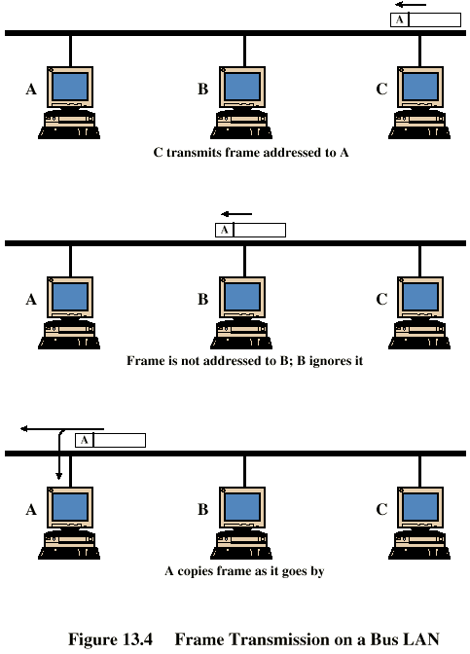
Bus Topology
Example:
  Station C want to transmit a frame of data to station A.

Slide 37
Bus Advantages and Disadvantages
Advantages
    Simple, easy to use and construct
    Requires smallest amount of cable (less expensive)
Disadvantages
    A faulty cable will take the entire LAN down
    Difficult to troubleshoot
    Heavy network traffic can slow bus considerably.

Slide 38
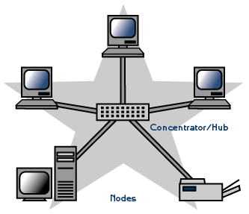
Star Topology
A physical Star topology connects the devices via a centralized unit such as a Hub or Switch.
Nodes communicate across the network by passing data through the central device.

Slide 39
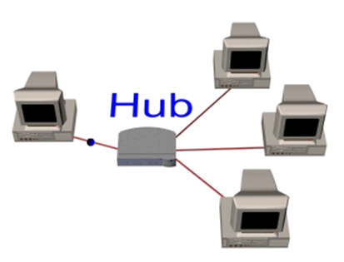
Star Topology
Broadcasted Star Topology(Hubbed Star)
    Through a hub which sends message out of all ports
    Physical star, logically bus
    Only one station can transmit at a time

Slide 40
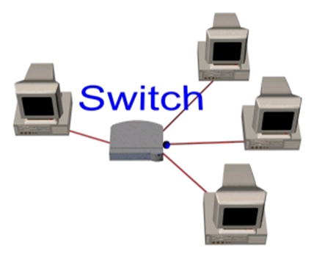
Switched Star Topology (Switched Star)
Through a switch which sends messages to only destination computer

Slide 41
Star Advantages
Single computer failure doesn’t bring down whole network
Adding new devices to a Star network is very simple compared to any of the other topologies
No disruptions to the network when connecting or removing devices.
Centralized control
Centralized network/hub monitoring
Easy to troubleshoot

Slide 42
Star Disadvantages
If central device fails, the whole network fails
Compared to the bus topology, a star network generally requires more cable
More expensive than linear bus topologies because of the cost of the central device

Slide 43
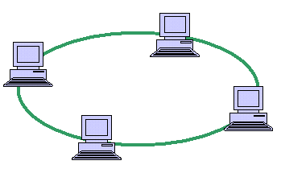
Ring Topology
All devices are connected to one another in the shape of a closed loop, so that each device is connected directly to two other devices, one on either side of it.
Data is passed one way from device to device.

Slide 44
Ring Topology
A short message (called a token) is circulated around the ring, being passed from station to station.
The token originates from a controller or master station which inserts it onto the ring.
A station which wants to transmit waits for the token to arrive.
When the token arrives, the station changes it from a token to a connector message, and appends its message. This new message is then placed on the outgoing side of the ring.

Slide 45
Ring Topology
Each station passes on received tokens if they have nothing to transmit.
They monitor connector messages to see if the message is addressed to them.
If connector messages are addressed to them, they copy the message, modify it to signify its receipt, then send it on around the ring.
Connector messages which are not addressed to them are passed directly on to the next station in the ring.

Slide 46
Ring Topology
When the connector message travels full circle and arrives at the original sending station, it checks the message to see if it's been received. It then discards the message and replaces it with a token.

Slide 47
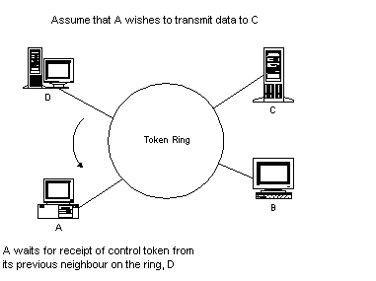
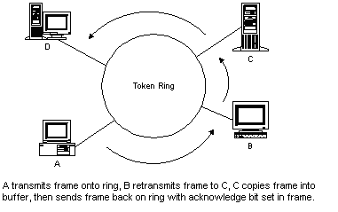
Frame Transmission - Ring LAN

Slide 48
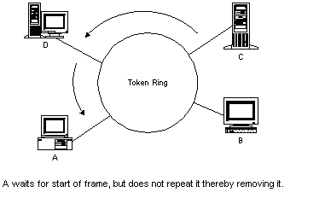
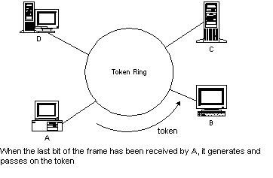
Frame Transmission - Ring LAN

Slide 49
Ring Advantages and Disadvantages
Advantages
  Equal access for all users
  Perform well under heavy traffic
Disadvantages
  If one device/cable fails then the whole network goes down.
  Difficult to troubleshoot
  Adding/Removing computers disrupts the whole network

Slide 50
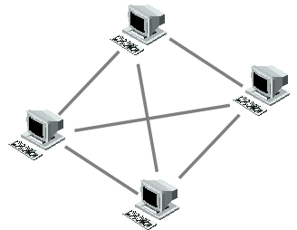
Mesh Topology
In a mesh topology each device/PC is connected to every other device/PC in the network by its own cable

Slide 51
Mesh Types
Full Mesh
Partial Mesh

Slide 52
Mesh Advantages and Disadvantages
Advantages
  Mesh topology boasts the highest fault tolerance of all of the network topologies.
Disadvantages
  Because each connection needs its own cable a Mesh topology can get very expensive.

Slide 53
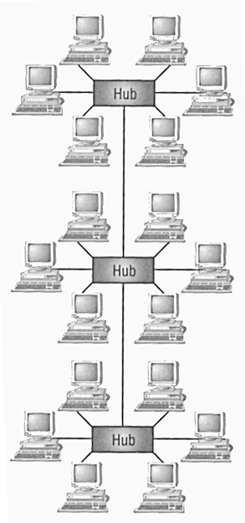
Hybrid Topology
Hybrid means that there is more than one topology exist
Stared Bus
  Groups of star-configured networks are connected to a linear bus backbone

Slide 54
Hybrid Advantages and Disadvantages
Advantages:
  Network expansion is simple
Disadvantages:
  If hub fails connections between failed hub and other hubs will fail

Slide 55
Number System
Is the system of naming or representing numbers.
There are different types of number systems namely;
    Decimal (Base – 10)
    Binary (Base – 2)
    Octal (Base – 8)
    Hexadecimal (Base – 16)

Slide 56
QUIZ
Find the binary, octal and hexadecimal equivalent of the following:
    16₁₀
    80₁₀
    240₁₀
Find the decimal, octal and hexadecimal equivalent of the following:
    1010101
    11110101
    111101011110

Slide 57
END
THANK YOU

